Slide 1
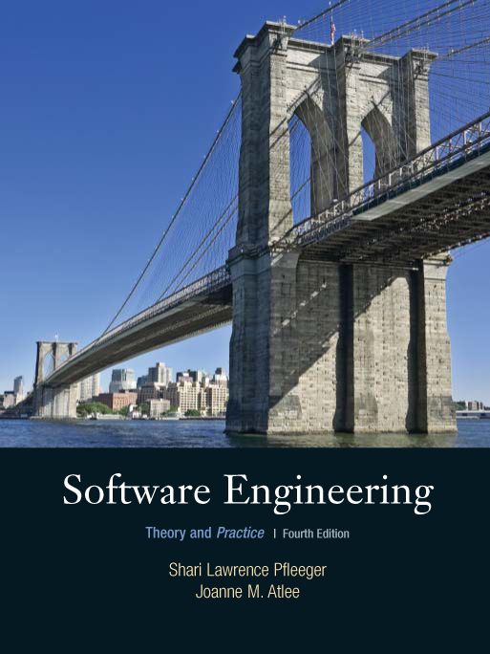
Chapter 4
Capturing
the Requirements
Shari L. Pfleeger
Joanne M. Atlee
4th Edition

Slide 2
Chapter 4 Objectives
Eliciting requirements from the customers
Modeling requirements
Reviewing requirements to ensure their quality
Documenting requirements for use by the design and test teams

Slide 3
4.1 The Requirements Process
A requirement is an expression of desired behavior
A requirement deals with
  objects or entities
  the state they can be in
  functions that are performed to change states or object characteristics
Requirements focus on the customer needs, not on the solution or implementation
  designate what behavior, without saying how that behavior will be realized

Slide 4
4.1 The Requirements Process
Sidebar 4.1 Why Are Requirements Important?
Top factors that caused project to fail
  Incomplete requirements
  Lack of user involvement
  Unrealistic expectations
  Lack of executive support
  Changing requirements and specifications
  Lack of planning
  System no longer needed
Some part of the requirements process is involved in almost all of these causes
Requirements error can be expensive if not detected early

Slide 5
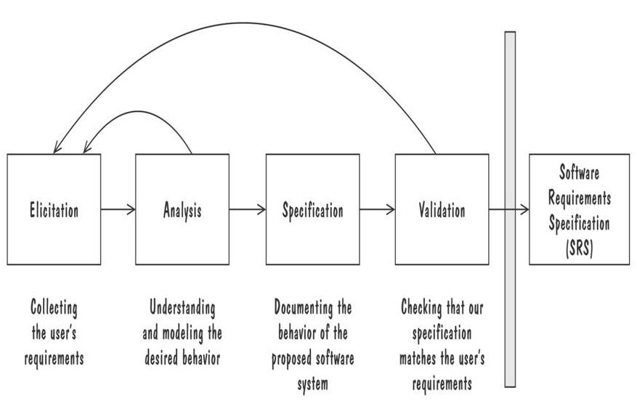
4.1 The Requirements Process
Process for Capturing Requirements
Performed by the req. analyst or system analyst
The final outcome is a Software Requirements Specification (SRS) document

Slide 6
4.2 Requirements Elicitation
Customers do not always undertand what their needs and problems are
It is important to discuss the requirements with everyone who has a stake in the system
Come up with agreement on what the requirements are
  If we can not agree on what the requirements are, then the project is doomed to fail

Slide 7
4.2 Requirements Elicitation
Stakeholders
Clients: pay for the software to be developed
Customers: buy the software after it is developed
Users: use the system
Domain experts: familiar with the problem that the software must automate
Market Researchers: conduct surveys to determine future trends and potential customers
Lawyers or auditors: familiar with government, safety, or legal requirements
Software engineers or other technology experts

Slide 8
4.2 Requirements Elicitation
Means of Eliciting Requirements
Interviewing stake holders
Reviewing available documentations
Observing the current system (if one exists)
Apprenticing with users to learn about user's task in more details
Interviewing user or stakeholders in groups
Brainstorming with current and potential users

Slide 9
4.3 Types of Requirements
Functional requirement: describes required behavior in terms of required activities
Quality requirement or nonfunctional requirement: describes some quality characteristic that the software must posses
Design constraint: a design decision such as choice of platform or interface components
Process constraint: a restriction on the techniques or resources that can be used to build the system

Slide 10
4.3 Types of Requirements
Sidebar 4.4 Making Requirements Testable
Fit criteria form objective standards for judging whether a proposed solution satisfies the requirements
  It is easy to set fit criteria for quantifiable requirements
  It is hard for subjective quality requirements
Three ways to help make requirements testable
  Specify a quantitative description for each adverb and adjective
  Replace pronouns with specific names of entities
  Make sure that every noun is defined in exactly one place in the requirements documents

Slide 11
4.3 Types of Requirements
Resolving Conflicts
Different stakeholder has different set of requirements
  potential conflicting ideas
Need to prioritize requirements
Prioritization might separate requirements into three categories
  essential: absolutely must be met
  desirable: highly desirable but not necessary
  optional: possible but could be eliminated

Slide 12
4.4 Characteristics of Requirements
Correct
Consistent
Unambigious
Complete
Feasible
Relevant
Testable
Traceable

Slide 13
4.5 Modeling Notations
It is important to have standard notations for modeling, documenting, and communicating decisions
Modeling helps us to understand requirements thoroughly
  Holes in the models reveal unknown or ambiguous behavior
  Multiple, conflicting outputs to the same input reveal inconsistencies in the requirements

Slide 14
4.5 Modeling Notations
Entity-Relationship Diagrams
A popular graphical notational paradigm for representing conceptual models
Has three core constructs
  An entity: depicted as a rectangle, represents a collection of real-world objects that have common properties and behaviors
  A relationship: depicted as an edge between two entities, with diamond in the middle of the edge specifying the type of relationship
  An attribute: an annotation on an entity that describes data or properties associated with the entity

Slide 15
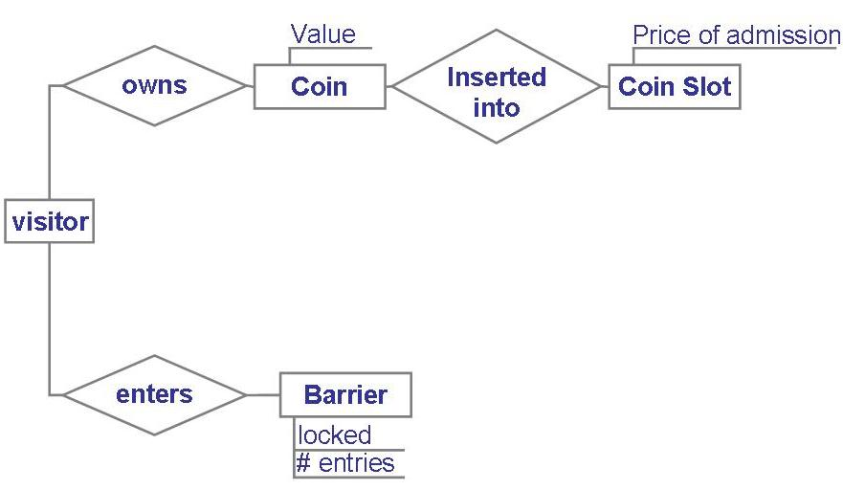
4.5 Modeling Notations
Entity-Relationship Diagrams (continued)
Entity diagram of turnstile problem

Slide 16
4.5 Modeling Notations
Entity-Relationship Diagrams (continued)
ER diagrams are popular because
  they provide an overview of the problem to be addressed
  the view is relatively stable when changes are made to the problem's requirements
ER diagram is likely to be used to model a problem early in the requirements process

Slide 17
4.5 Modeling Notations
ER Diagrams Example: UML Class Diagram
UML (Unified Modeling Language) is a collection of notations used to document software specifications and designs
It represents a system in terms of
  objects: akin to entities, organized in classes that have an inheritance hierarchy
  methods: actions on the object's variables
The class diagram is the flagship model in any UML specification
  A sophisticated ER diagram relating the classes (entities) in the specification

Slide 18
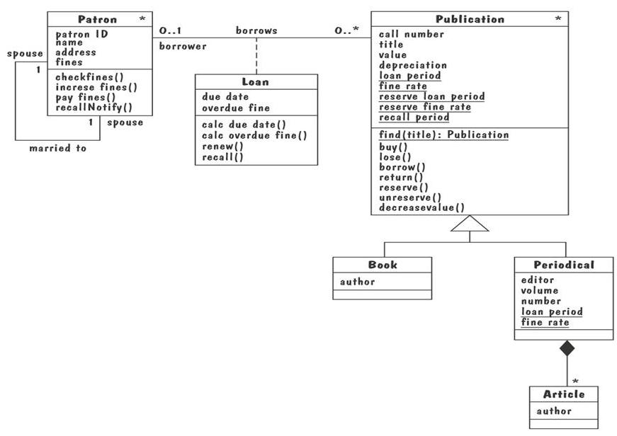
4.5 Modeling Notations
UML Class Diagram of Library Problem
∗
∗

Slide 19
4.5 Modeling Notations
UML Class Diagram (continued)
Attributes and operations are associated with the class rather than instances of the class
A class-scope attribute represented as an underlined attribute, is a data value that is shared by all instances of the class
A class-scope operation written as underlined operation, is an operation performed by the abstract class rather than by class instances
An association, marked as a line between two classes, indicates a relationship between classes' entities

Slide 20
4.5 Modeling Notations
UML Class Diagram (continued)
Aggregate association is an association that represents interaction, or events that involve objects in the associated (marked with white diamond)
  “has-a” relationship
Composition association is a special type of aggregation, in which instances of the compound class are physically constructed from instances of component classes (marked with black diamond)

Slide 21
4.5 Modeling Notations
Event Traces
A graphical description of a sequence of events that are exchanged between real-world entities
  Vertical line: the timeline of distinct entity, whose name appear at the top of the line
  Horizontal line: an event or interaction between the two entities bounding the line
  Time progresses from top to bottom
Each graph depicts a single trace, representing one of several possible behaviors
Traces have a semantic that is relatively precise, simple and easy to understand

Slide 22
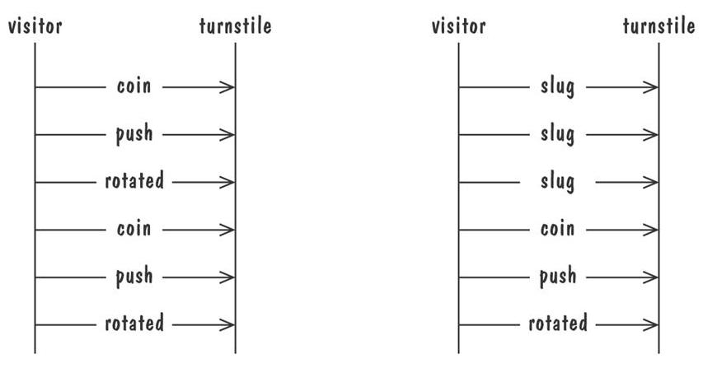
4.5 Modeling Notations
Event Traces (continued)
Graphical representation of two traces for the turnstile problem
  trace on the left represents typical behavior
  trace on the right shows exceptional behavior

Slide 23
4.5 Modeling Notations
Event Traces Example: Message Sequence Chart
An enhanced event-trace notation, with facilities for creating and destroying entities, specifiying actions and timers, and composing traces
  Vertical line represents a participating entity
  A message is depicted as an arrow from the sending entity to the receiving entity
  Actions are specified as labeled rectangles positioned on an entity's execution line
  Conditions are important states in an entity's evolution, represented as labeled hexagon

Slide 24
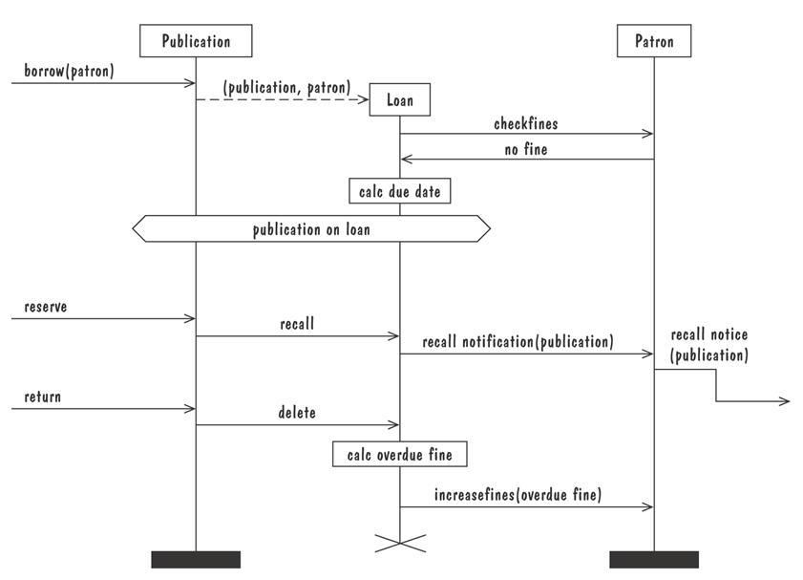
4.5 Modeling Notations
Message Sequence Chart (continued)
Message sequence chart for library loan transaction

Slide 25
4.5 Modeling Notations
State Machines
A graphical description of all dialog between the system and its environment
  Node (state) represents a stable set of conditions that exists between event occurences
  Edge (transition) represents a change in behavior or condition due to the occurrence of an event
Useful both for specifying dynamic behavior and for describing how behavior should change in response to the history of events that have already occurred

Slide 26
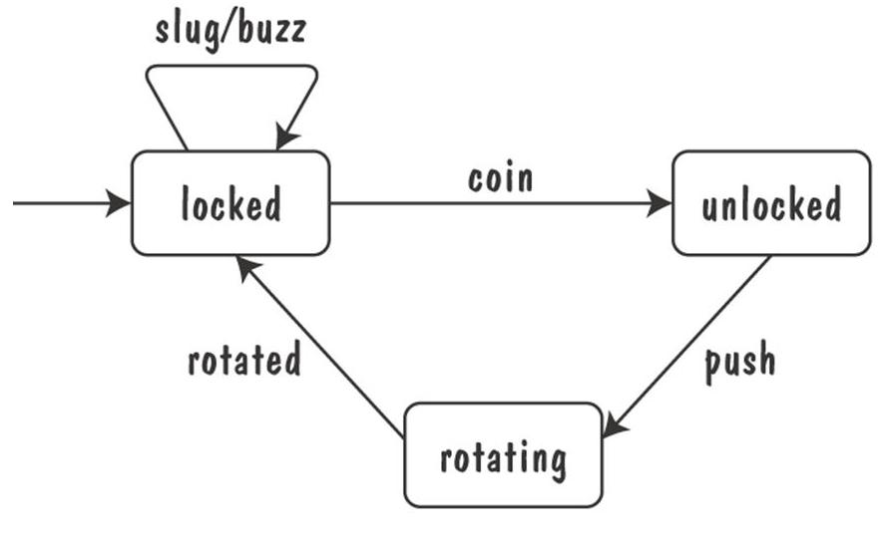
4.5 Modeling Notations
State Machines (continued)
Finite state machine model of the tunstile problem

Slide 27
4.5 Modeling Notations
Data-Flow Diagrams
ER diagram, event trace, state machines depict only lower-level behaviors
A data-flow diagram (DFD) models functionality and the flow of data from one function to another
  A buble represents a process
  An arrow represents data flow
  A data store: a formal repository or database of information
  Rectangles represent actors: entities that provide input data or receive the output result

Slide 28
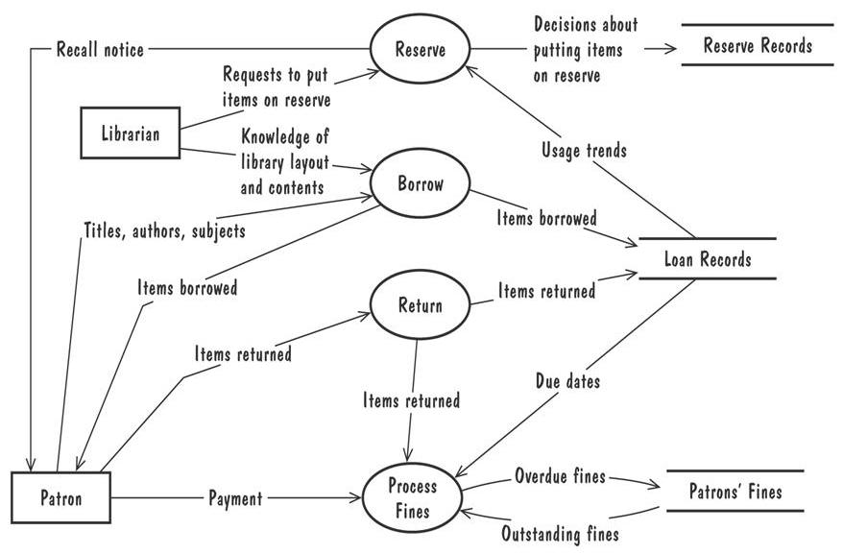
4.5 Modeling Notations
Data-Flow Diagrams (continued)
A high-level data-flow diagram for the library problem

Slide 29
4.5 Modeling Notations
Data-Flow Diagrams (continued)
Advantage:
  Provides an intuitive model of a proposed system's high-level functionality and of the data dependencies among various processes
Disadvantage:
  Can be aggravatingly ambiguous to a software developer who is less familiar with the problem being modeled

Slide 30
4.5 Modeling Notations
Data-Flow Diagrams Example: Use Cases
Components
  A large box: system boundary
  Stick figures outside the box: actors, both human and systems
  Each oval inside the box: a use case that represents some major required functionality and its variant
  A line between an actor and use case: the actor participates in the use case
Use cases do not model all the tasks, instead they are used to specify user views of essential system behavior

Slide 31
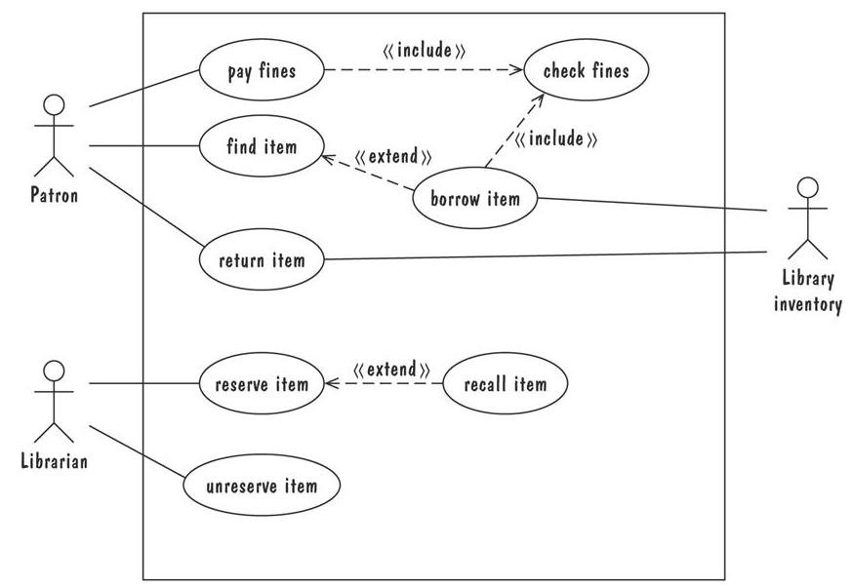
4.5 Modeling Notations
Use Cases (continued)
Library use cases including borrowing a book, returning a borrowed book, and paying a library fine

Slide 32
4.5 Modeling Notations
Functions and Relations
Formal methods or approach: mathematically based specification and design techniques
Formal methods model requirements or software behavior as a collection of mathematical functions or relations
  Functions specify the state of the system's execution, and output
  A relation is used whenever an input value maps more than one ouput value
Functional method is consistent and complete

Slide 33
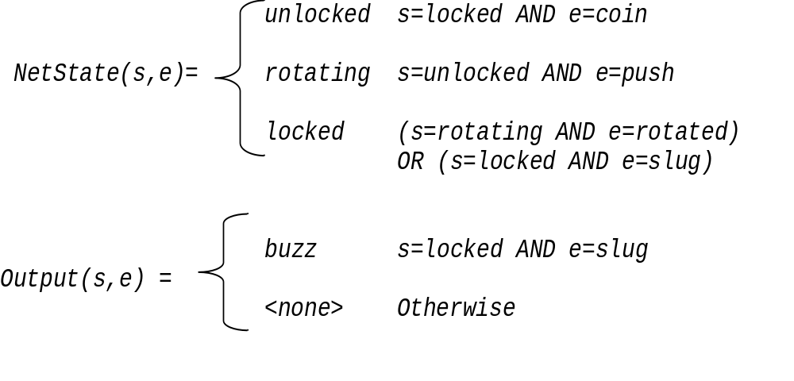
4.5 Modeling Notations
Functions and Relations (continued)
Example: representing turnstile problem using two functions
  One function to keep track of the state
  One function to specify the turnstile output

Slide 34
4.5 Modeling Notations
Functions and Relations Example: Decision Tables
It is a tabular representation of a functional specification that maps events and conditions to appropriate reponses or action
The specification is formal because the inputs (events and conditions) and outputs (actions) may be expressed in natural language
If there is n input conditions, there are 2^{n} possible combination of input conditions
Combinations map to the same set of result can be combined into a single column

Slide 35
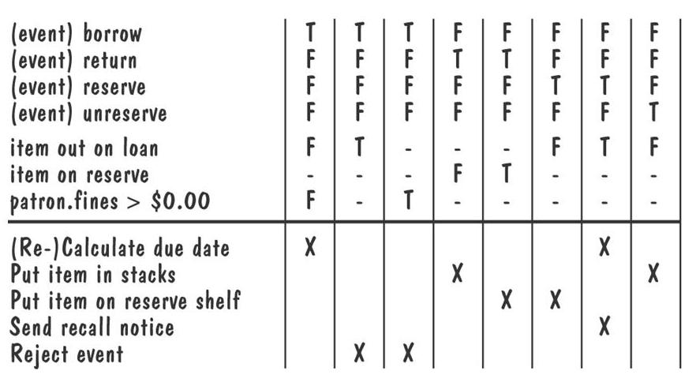
4.5 Modeling Notations
Decision Tables (continued)
Decision table for library functions borrow, return, reserve, and unreserve

Slide 36
4.7 Prototyping Requirements
Building a Prototype
To elicit the details of proposed system
To solicit feedback from potential users about
  what aspects they would like to see improve
  which features are not so useful
  what functionality is missing
Determine whether the customer's problem has a feasible solution
Assist in exploring options for otimizing quality requirements

Slide 37
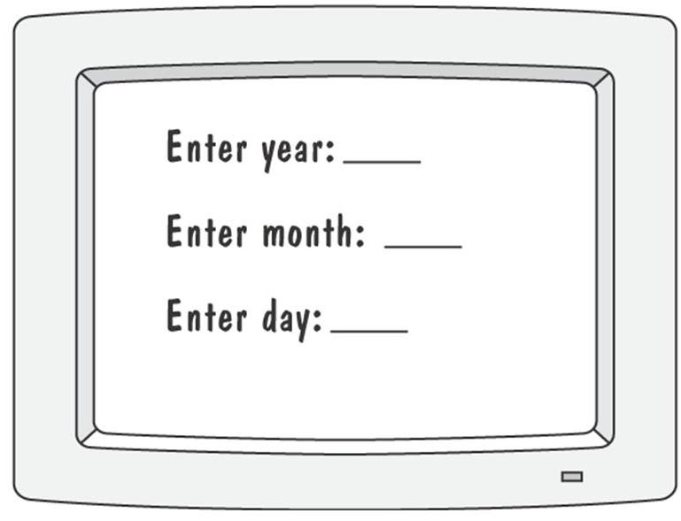
4.7 Prototyping Requirements
Prototyping Example
Prototype for building a tool to track how much a user exercises each day
Graphical respresentation of first prototype, in which the user must type the day, month and year

Slide 38
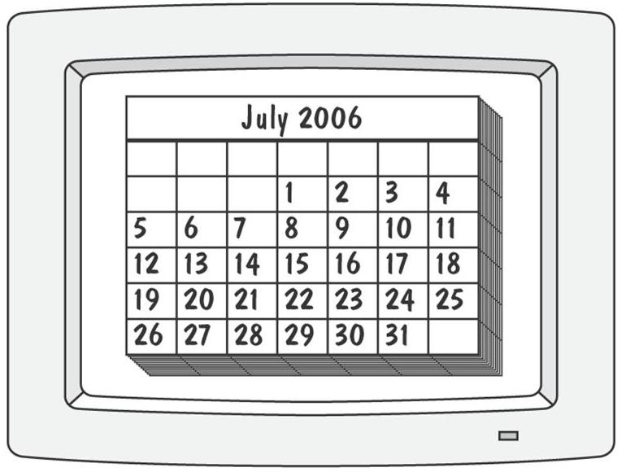
4.7 Prototyping Requirements
Prototyping Example (continued)
Second prototype shows a more interesting and sophisticated interface involving a calendar
  User uses a mouse to select the month and year
  The system displays the chart for that month, and the user selects the appropriate date in the chart

Slide 39
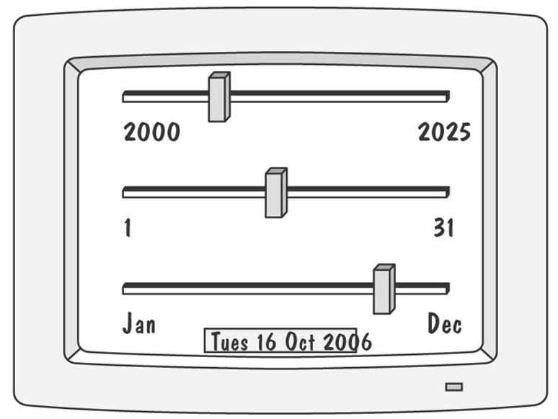
4.7 Prototyping Requirements
Prototyping Example (continued)
Third prototype shows that instead of calendar, the user is presented with three slide bars
  User uses the mouse to slide each bar left or right
  The box at the bottom of the screen changes to show the selected day, month, and year

Slide 40
4.7 Prototyping Requirements
Approaches to Prototyping
Throwaway approach
  Developed to learn more about a problem or a proposed solution, and that is never intended to be part of the delivered software
  Allow us to write “quick-and-dirty”
Evolutionary approach
  Developed not only to help us answer questions but also to be incorporated into the final product
  Prototype has to eventually exhibit the quality requirements of the final product, and these qualities cannot be retrofitted
Both techniques are sometimes called rapid prototyping

Slide 41
4.7 Prototyping Requirements
Prototyping vs. Modeling
Prototyping
  Good for answering questions about the user interfaces
Modeling
  Quickly answer questions about constraints on the order in which events should occur, or about the synchronization of activities

Slide 42
4.8 Requirements Documentation
Requirement Definition: Steps Documenting Process
Outline the general purpose and scope of the system, including relevant benefits, objectives, and goals
Describe the background and the rationale behind proposal for new system
Describe the essential characteristics of an accepatable solution
Describe the environment in which the system will operate
Outline a description of the proposal, if the customer has a proposal for solving the problem
List any assumptions we make about how the environment behaves

Slide 43
4.8 Requirements Documentation
Process Management and Requirements Traceability
Process managemet is a set of procedures that track
  the requirements that define what the system should do
  the design modules that are generated from the requirement
  the program code that implements the design
  the tests that verify the functionality of the system
  the documents that describe the system
It provides the threads that tie the system parts together

Slide 44
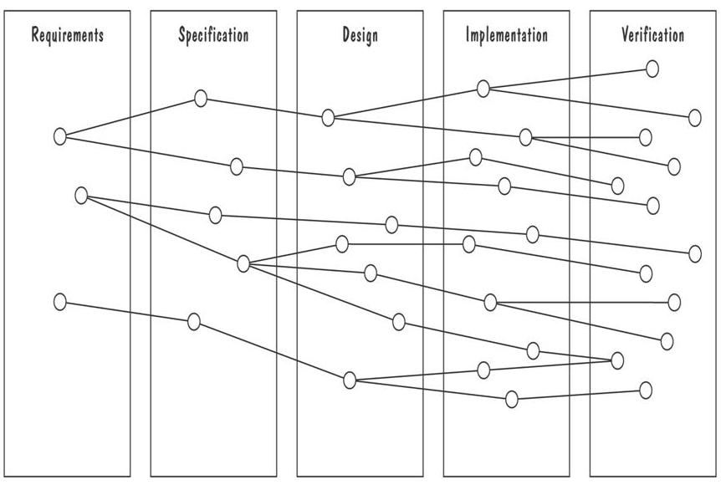
4.8 Requirements Documentation
Development Activities
Horizontal threads show the coordination between development activities

Slide 45
4.9 Validation and Verification
In requirements validation, we check that our requirements definition accurately reflects the customer's needs
In verification, we check that one document or artifact conforms to another
Verification ensures that we build the system right, whereas validation ensures that we build the right system

Slide 46
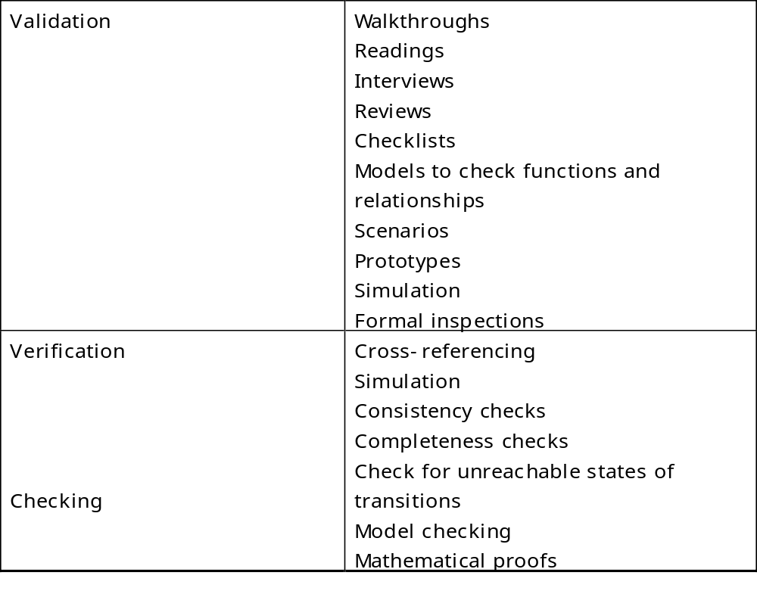
4.9 Validation and Verification
List of techniques to validate requirements

Slide 47
4.9 Validation and Verification
Requirements Review
Review the stated goals and objectives of the system
Compare the requirements with the goals and objectives
Review the environment in which the system is to operate
Review the information flow and proposed functions
Assess and document the risk, discuss and compare alternatives
Testing the system: how the requirements will be revalidated as the requirements grow and change

Slide 48
4.9 Validation and Verification
Verification
Check that the requirements-specification document corresponds to the requirements-definition
Make sure that if we implement a system that meets the specification, then the system will satisfy the customer's requirements
Ensure that each requirement in the definition document is traceable to the specification

Slide 49
4.14 What This Chapter Means for You
It is essential that the requirements definition and specification documents describe the problem, leaving solution selection to designer
There are variety of sources and means for eliciting requirements
There are many different types of definition and specification techniques
The specification techniques also differ in terms of their tool support, maturity, understandability, ease of use, and mathematical formality
Requirements questions can be answered using models or prototypes
Requirements must be validated to ensure that they accurately reflect the customer's expectations

